Slide 1

PROJECT BASED LEARNING

Slide 2
PROJECT OVERVIEW
This Program is a simple Word Puzzle Game formed by using C++ language and Certain Datatypes.
Basically, A puzzle of words alphabets is shown on screen you have to guess a hidden correct Word from the puzzle for each correct guessing you will get one score.

Slide 3
CONTENTS
1
4
INFO ABOUT TEAM MEMBERS
WORKING
2
5
C++ AT A GLANCE
BIBLIOGRAPHY
3
BASIC STRUCTURE OF PROJECT

Slide 4
TEAM MEMBERS
BRANCH: IT(B)
Sumit Sahu (0905IT201088)
Vishal Garg (0905IT201098)
Shraddha Sharma (0905IT201080)
Sumukh Sharma (0905IT201089)

Slide 5
C++
C++ is a cross-platform language that can be used to create high-performance applications. It was developed by Bjarne Stroustrup, as an extension to the C language. The language was updated 3 major times in 2011, 2014, and 2017 to C++11, C++14, and C++17.
C++ was designed with an orientation toward system programming and embedded, resource-constrained software and large systems, with performance, efficiency, and flexibility of use as its design highlights. C++ has also been found useful in many other contexts, with key strengths being software infrastructure and resource-constrained applications, including desktop applications, video games, servers (e.g. e-commerce, web search, or databases), and performance-critical applications (e.g. telephone switches or space probes)

Slide 6
Why Use C++?
C++ is one of the world’s most popular programming languages.
C++ can be found in today’s operating systems, Graphical User Interfaces, and embedded systems.
C++ is an object-oriented programming language that gives a clear structure to programs and allows code to be reused, lowering development costs.
C++ is portable and can be used to develop applications that can be adapted to multiple platforms.
C++ is fun and easy to learn!
As C++ is close to C# and Java, it makes it easy for programmers to switch to C++ or vice versa.

Slide 7
Algorithm:
Step 1- Initialize an array of string with different words.
Step 2- Declare a 2D array for puzzle box.
Step 3- Randomly assign different letters to different locations using rand() function.
Step 4- Randomly pic the location of 2D array using rand() let its I th row and j th column
Step 5- Randomly pic the array index to choose the word let its p.
Step 6- Set the string present at pth location in puzzle box horizontally or vertically as you wish starting from I th location.
Step 7- Print the puzzle box
Step 8- Ask the user to guess the word hidden in puzzle box.
Step 9- Compare the answer with pth location of strings.
Step 10-If it is correct user wins else user loss.

Slide 8
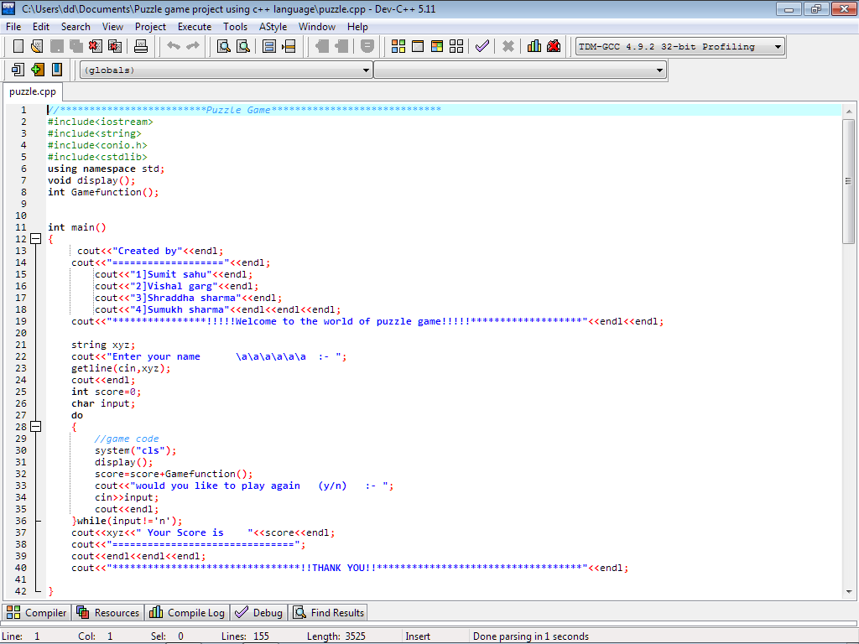
Source Code:-
Source Code

Slide 9
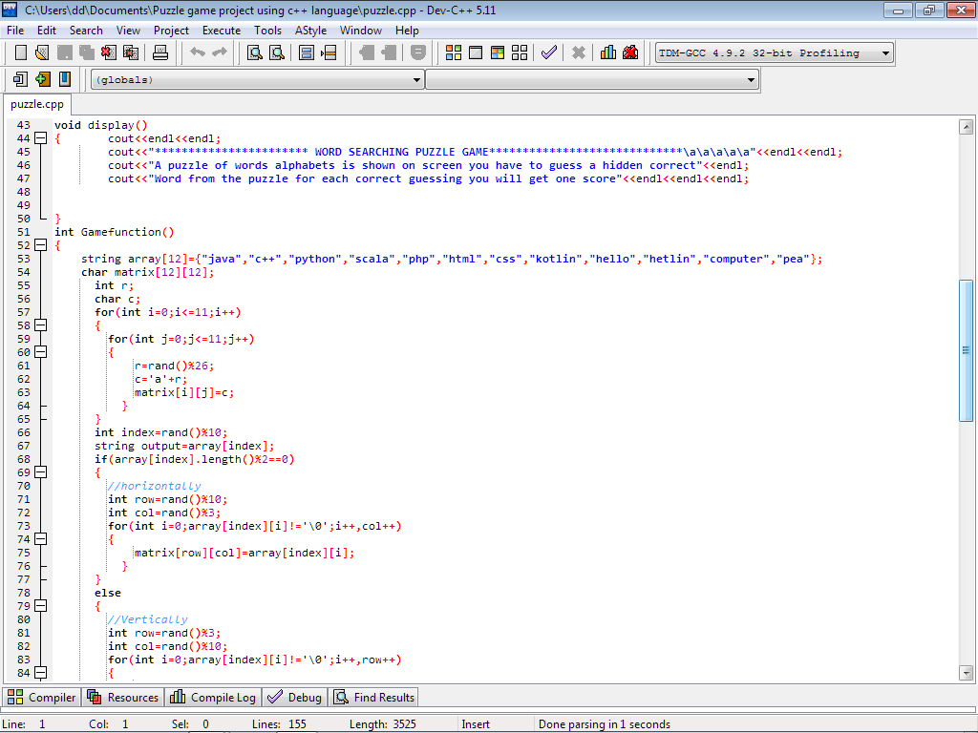

Slide 10
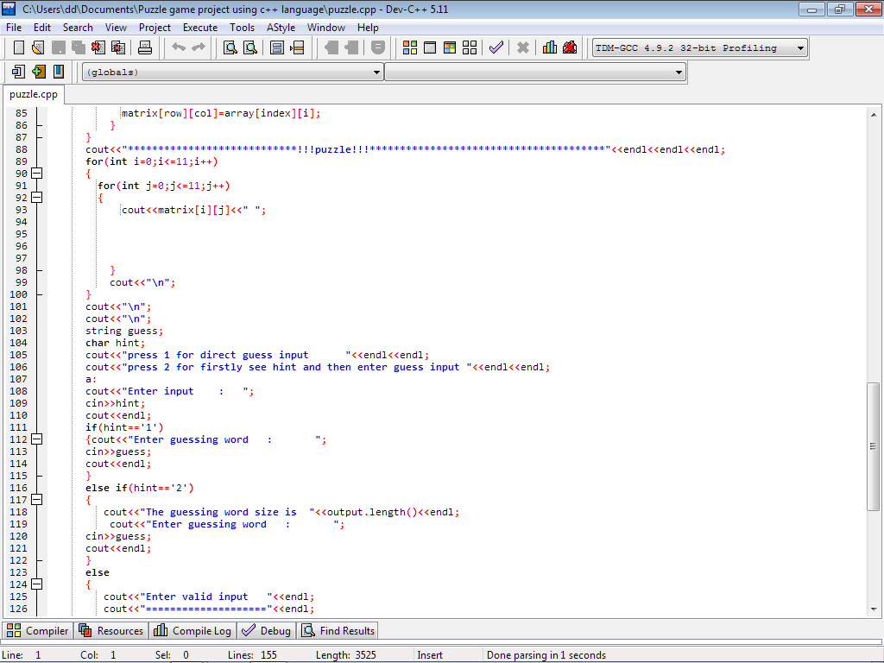

Slide 11
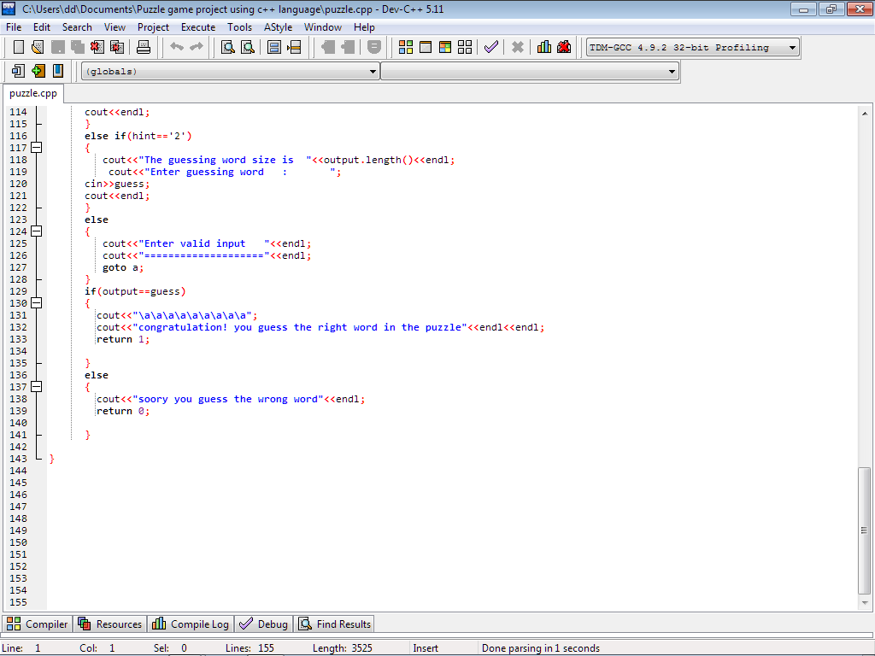

Slide 12
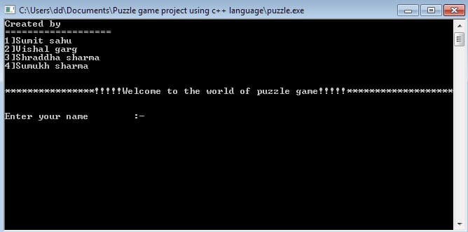
Program interface:-

Slide 13
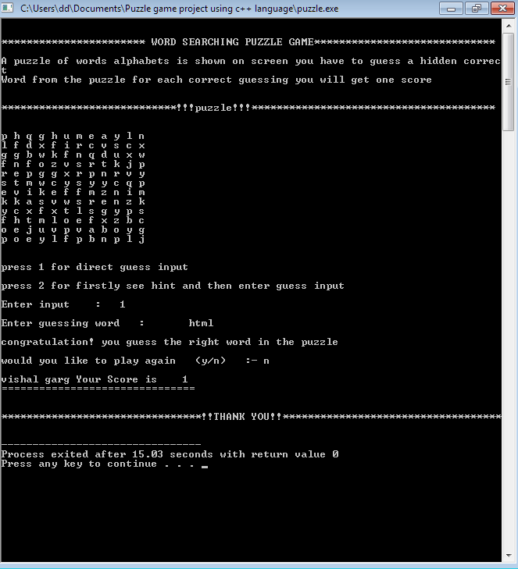

Slide 14
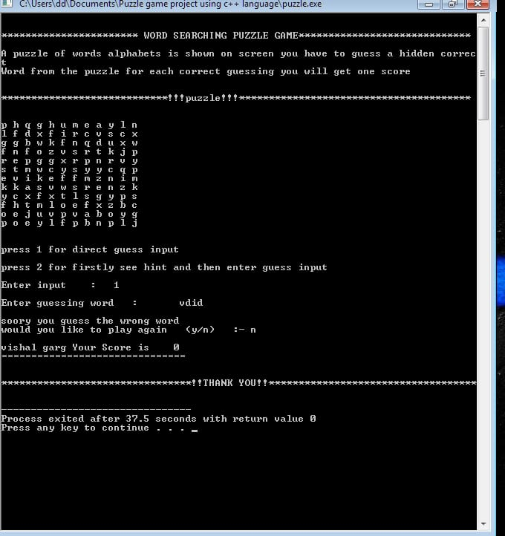

Slide 15
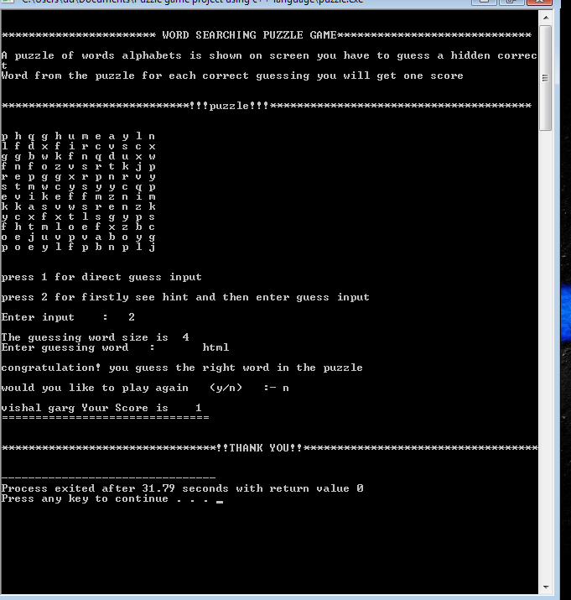

Slide 16
BIBILIOGRAPHY
C++ Programming language
Dev C++
Let us C++ - Yashavant P. Kanetkar
PBL Mentor : Ms. Reena chauhan

